Slide 1
Assessment Strategy Overview School of Chemical & Bioprocess Engineering
Assessment Integrity in the Era of Large Language Models: Threats and Opportunities within the UCD College of Engineering & Architecture
June 2023

Slide 2
100,000
513
116,849
modules offered by the
College of Engineering & Architecture in 2022/23
student credits taught* by the
College of Engineering & Architecture in 2022/23
67
13, 896
modules offered by the
School of Chemical & Bioprocess Engineering
in 2022/23
student credits taught* by the
School of Chemical & Bioprocess Engineering
in 2022/23
46
Level 4
2
Level 5
School of Chemical & Bioprocess Engineering
number of modules by level
2
Level 1
7
Level 2
10
Level 3
48
5-credit modules offered within the School
13
10-credit modules offered within the School
5
15+-credit modules offered within the School
147
different assessed components within modules offered by the School of Chemical & Bioprocess Engineering
in 2022/23
ME Chemical and Bioprocess Engineering
flagship course offered by the
School of Chemical & Bioprocess Engineering
Continuous Assessment
most common assessment type used within modules
offered by the School of Chemical & Bioprocess Engineering
in 2022/23
Journal
least common assessment type used within modules
offered by the School of Chemical & Bioprocess Engineering
in 2022/23
*Student Credits Taught = Module ECTS Credits × 2022/23 Enrolled Students

Slide 3
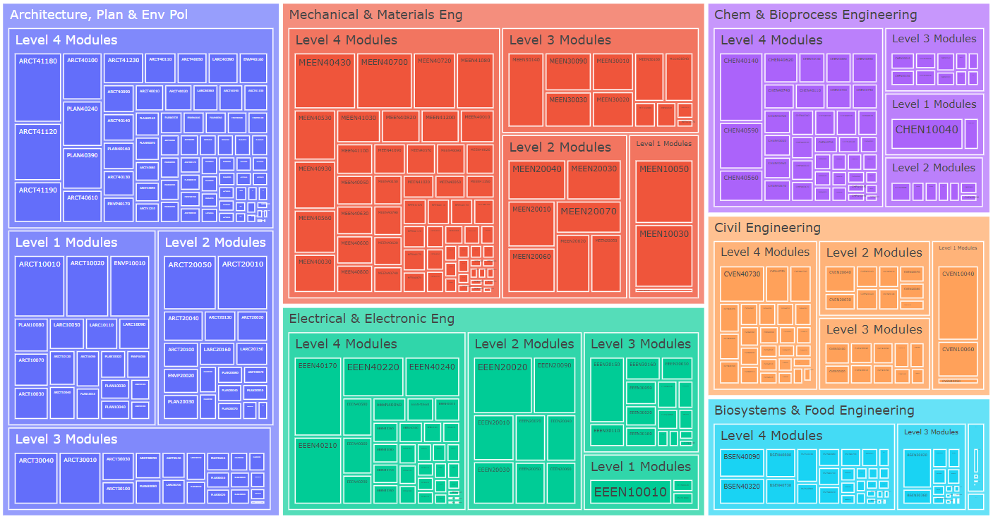
College of Engineering & Architecture – Modules by School
2022/23 Academic Year – Modules Weighted by Student Credits

Slide 4
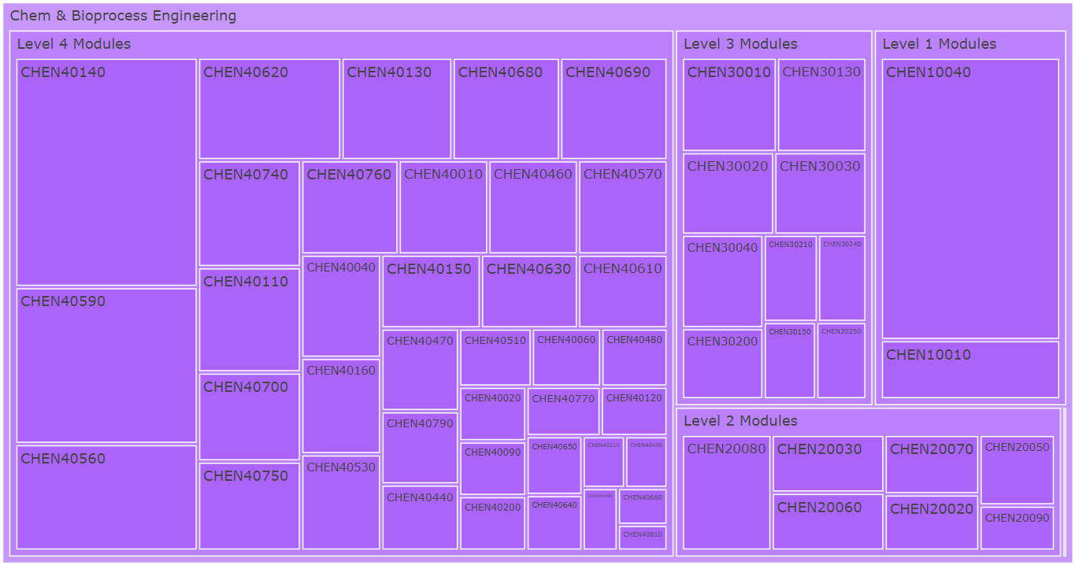
School of Chemical & Bioprocess Engineering Modules
2022/23 Academic Year – Modules Weighted by Student Credits

Slide 5
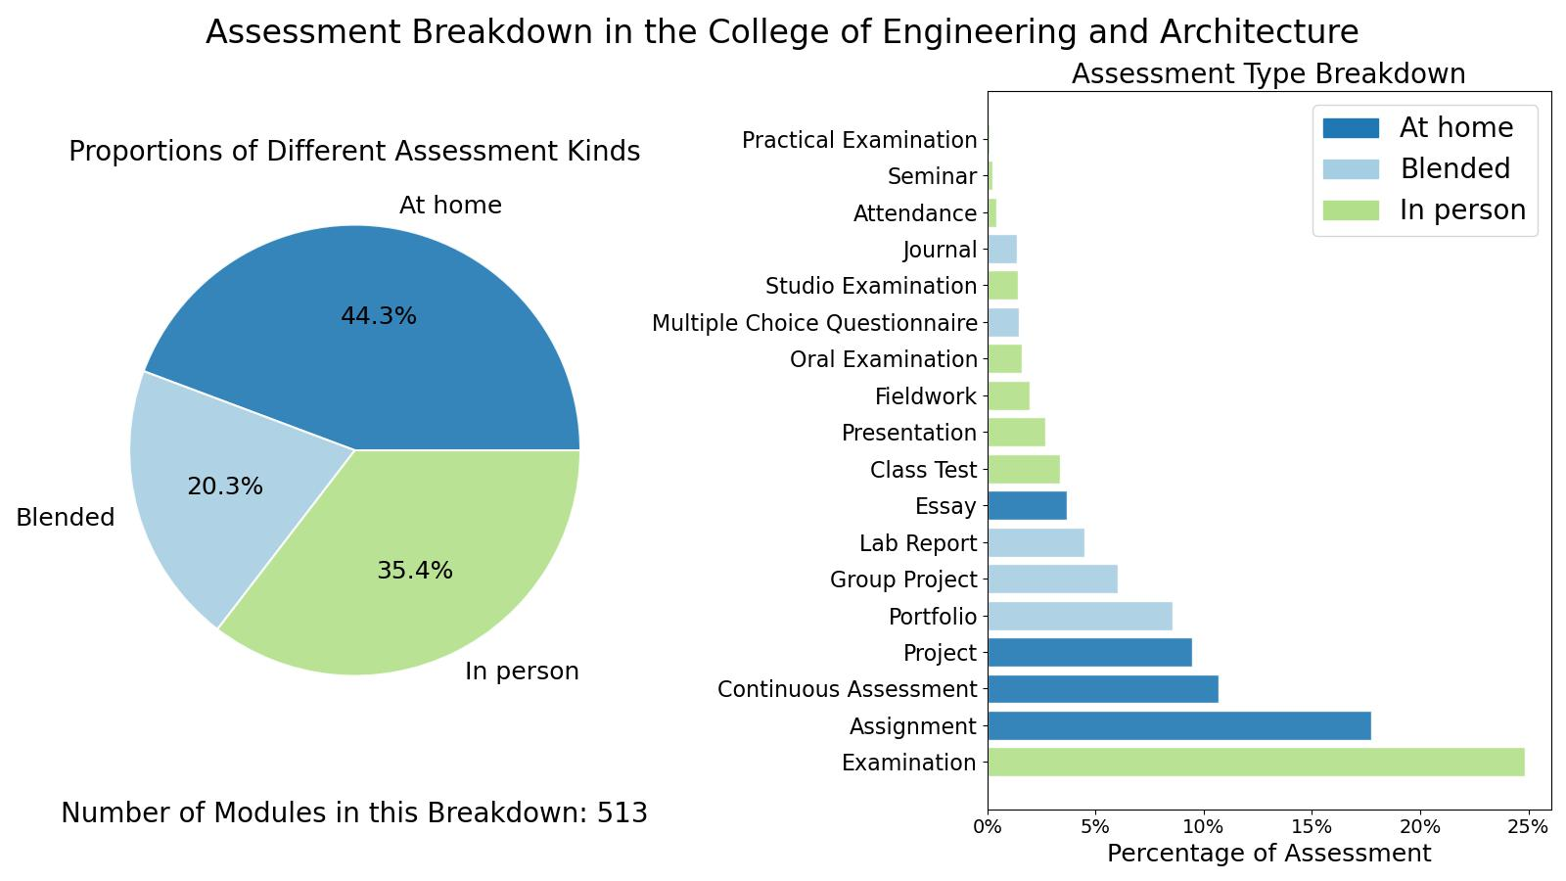
College of Engineering & Architecture

Slide 6
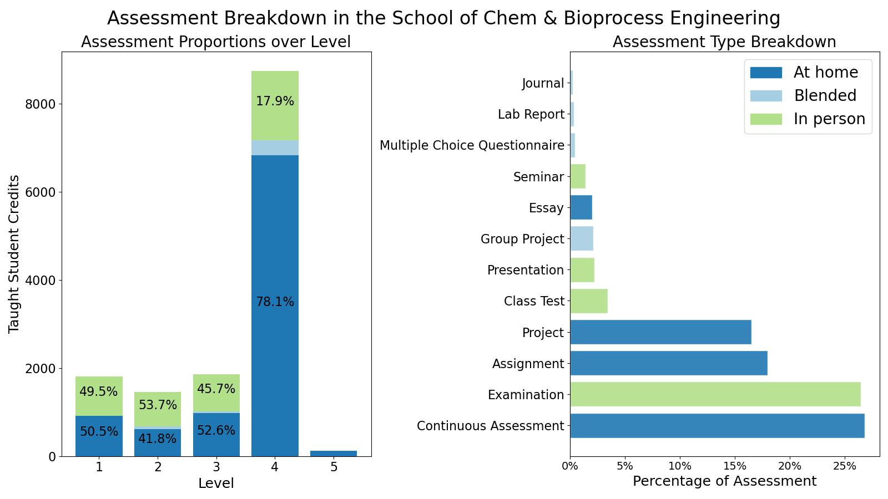
School of Chemical & Bioprocess Engineering

Slide 7
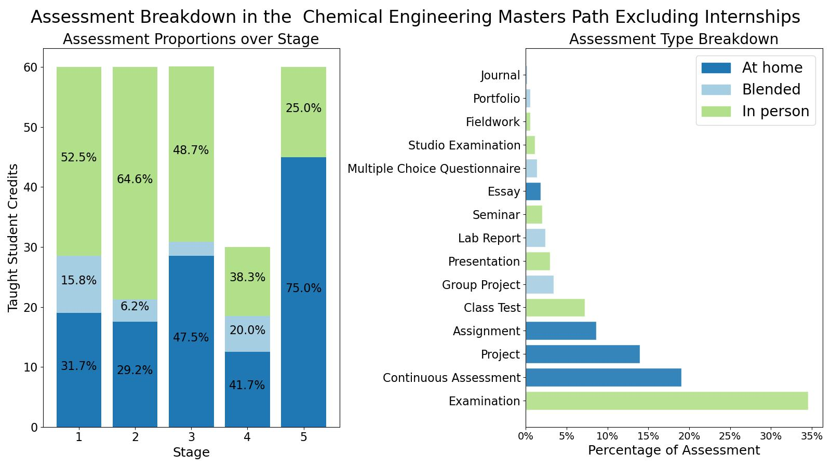
ME Chemical & Bioprocess Engineering

Slide 8
Assessment Strategy Overview School of Chemical & Bioprocess Engineering Assessment Integrity in the Era of Large Language Models: Threats and Opportunities within the UCD College of Engineering & Architecture June 2023

